Slide 1

EUREKA

Slide 2



Jingyao Wu
PhD student in Bioengineering
Xiaolong Cui
PhD student in Computer Science
Jingming Chen
PhD student in Bioengineering
Notes:
Good evening we are team Eureka

Slide 3
Eureka is a one-stop web platform for researchers to TRACK and SHARE scientific publications
Notes:
today we are here to introduce you Eureka, a one stop web platform for researchers to track and share scientific publications.

Slide 4


Slide 5
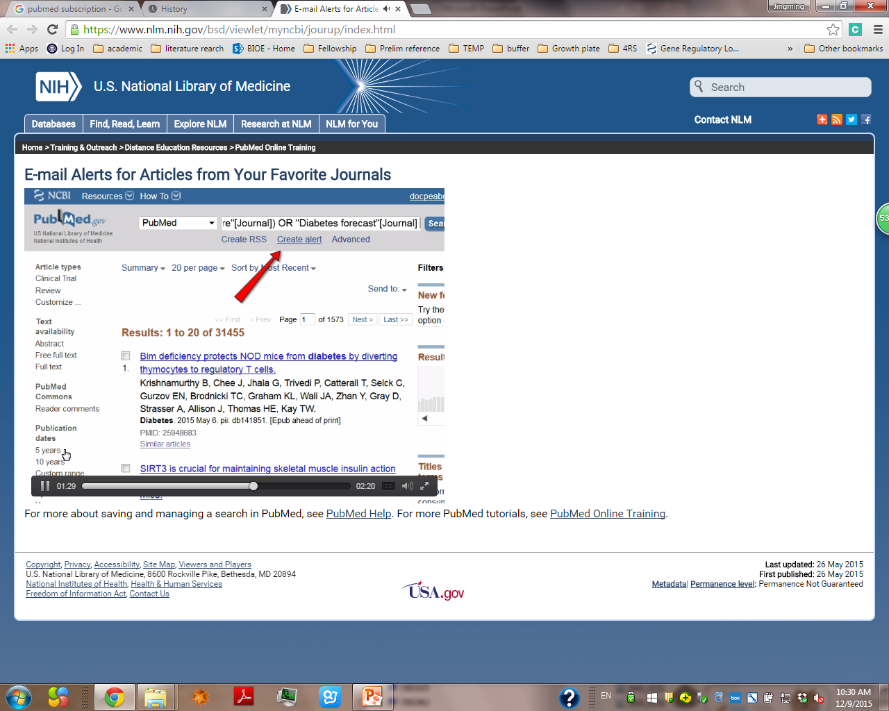
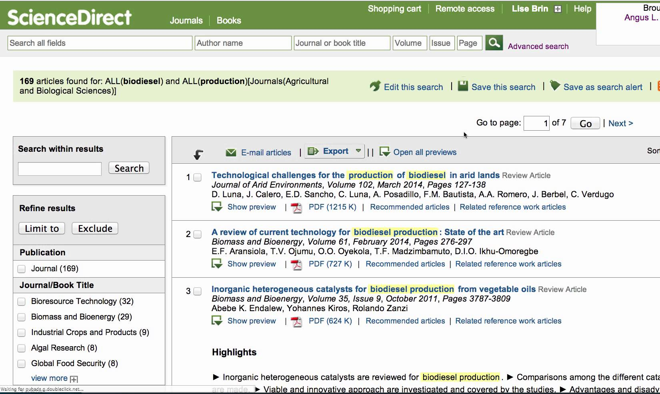
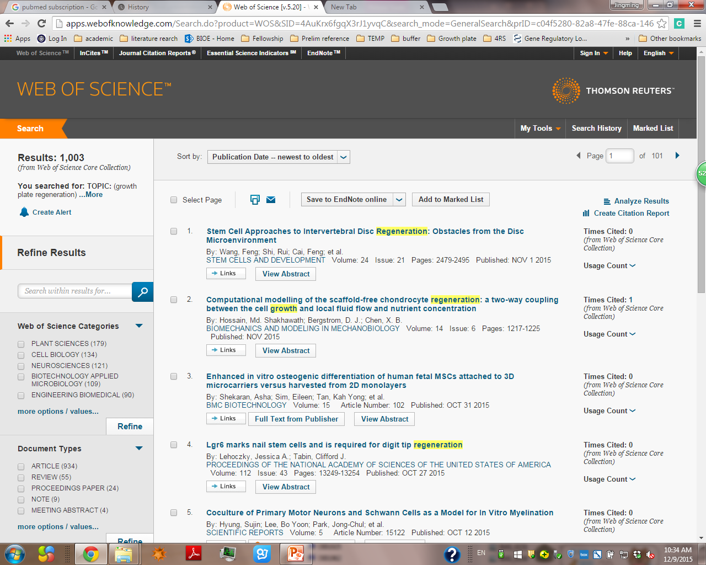
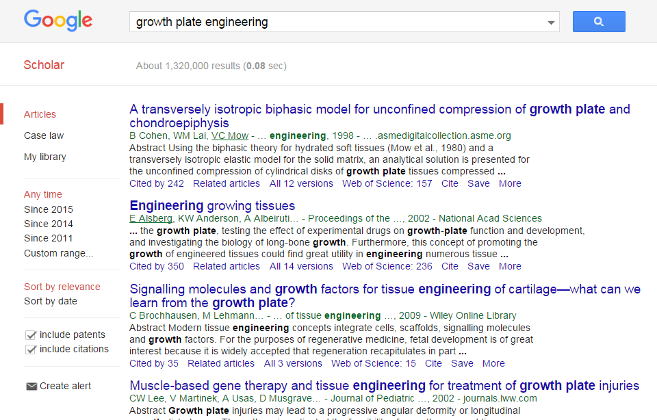
Cross-platform
Complicate
Inaccurate

Slide 6

1.3 Million
8%↑
https://cmwpro.files.wordpress.com/2008/05/j0422183.jpg

Slide 7
20 000 000 scientists
×
100 days/year
×
0.5 hour
=
1 Billion Hours

Slide 8
Eureka is a one-stop web platform for researchers to TRACK and SHARE scientific publications
Notes:
today we are here to introduce you Eureka, a one stop web platform for researchers to track and share scientific publications.

Slide 9

EUREKA

Slide 10

Eureka newsfeed
Topic
Author
Journal

Slide 11
Eureka newsfeed
Download to local
Store in cloud
Share with individual or group

Slide 12
Revenue model I
25 400 scientific journals
Top 20% journals
Middle 75% journals
Free distribution
Membership fee $1000/year,
Promotion fee $5000/time
5% New journals

Slide 13
Revenue model II
laboratory testing
+
wholesale supply
II
$50 billion

Slide 14
Advertising for laboratory product
~$100 M market

Slide 15

In 3 years, we will..
90%
= 1 000 000 publications

Slide 16
In 3 years, we will..
60%
= 12 000 000 users

Slide 17
3+ years…
Cost
Revenue
$10 M revenue in 2022
Break-even in 2020

Slide 18
Thanks!
EUREKA
A one-stop web platform for researchers to TRACK and SHARE scientific publications

